Slide 1

ExpressJs Basics

Slide 2
Content
a) Introduction to REST APIs
b) HTTP Methods
c) Creating Express Server
d) Middleware in Express
e) CORS
f) MongoDB Connection
g) Mongoose Models
h) CRUD Operations
i) Database Error Handling
Introducing yourself
Engaging the audience
Visual appeal
Effective delivery techniques
Q&A

Slide 3
1. Introduction to REST APIs
REST stands for Representational State Transfer.
REST is an architectural style used to design web services.
Enables communication between frontend and backend applications.
Uses HTTP protocols for sending and receiving data.
Follows a client-server architecture.
Uses resources identified by URLs.
Commonly exchanges data in JSON format.
Supports stateless communication between client and server.

Slide 4
2. HTTP Methods
HTTP methods define the type of operation performed on a resource.
Each method represents a specific action in API communication.
HTTP methods help organize API endpoints according to their operations.
HTTP status codes indicate the result of an API request.
Method | Purpose
GET | Retrieve data from the server.
POST | Create a new resource.
PUT | Completely replace an existing resource.
PATCH | Partially update an existing resource.
DELETE | Remove an existing resource.

Slide 5
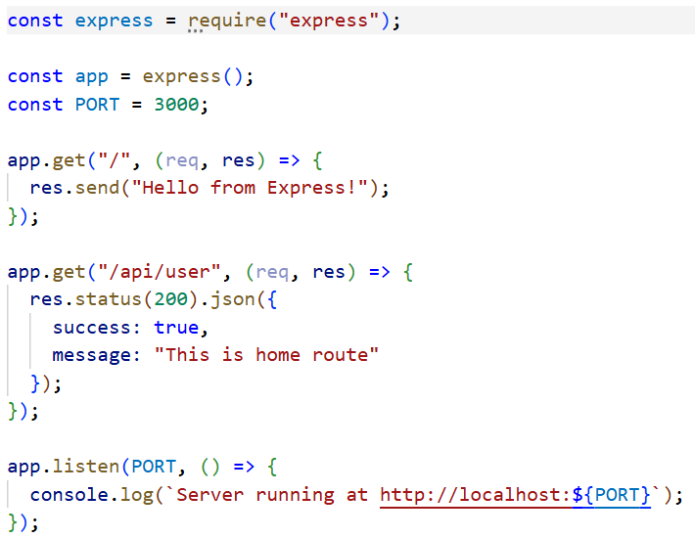
3. Creating an Express Server
Express.js is a lightweight and flexible web framework for Node.js.
Simplifies server creation and HTTP request handling.
Provides routing mechanisms to define API endpoints.
Supports middleware for processing requests.
Allows sending responses in JSON and other formats.
Uses app.listen() to start the server.

Slide 6
4. Middleware in Express
Middleware functions execute during the request-response cycle.
They have access to the request object, response object, and next() function.
Used to process requests before they reach route handlers.
Can modify request and response objects.
Can terminate requests or pass control to the next middleware.
Types of middleware:
  Application-level middleware.
  Router-level middleware.
  Built-in middleware.
  Third-party middleware.
  Error-handling middleware.

Slide 7
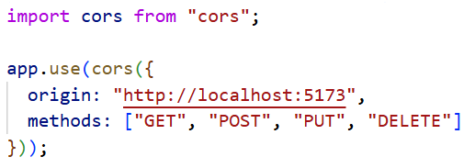
5. CORS (Cross-Origin Resource Sharing)
CORS is a browser mechanism that controls cross-origin HTTP requests.
Allows servers to specify which origins can access their resources.
Commonly required when frontend and backend applications run on different origins.
Uses HTTP response headers to define access permissions.
Some cross-origin requests trigger a preflight OPTIONS request.
CORS configuration can restrict access by origin, methods, and headers.

Slide 8
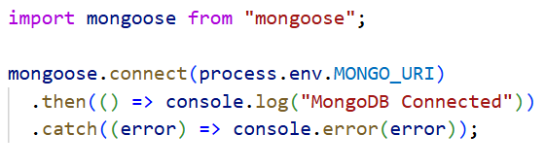
6. MongoDB Connection
MongoDB is a NoSQL document-oriented database.
Stores data in flexible BSON documents.
Organizes data into databases and collections.
Mongoose provides an ODM interface for MongoDB in Node.js.
Mongoose provides an ODM interface for MongoDB in Node.js.
Database connections enable backend applications to perform data operations.
Connection strings define database connection details.
Environment variables are commonly used to store database configuration.

Slide 9
7. Mongoose Models
Mongoose is an Object Data Modeling library for MongoDB.
A schema defines the structure and validation rules of documents.
A model is created using a schema.
Models provide methods to interact with MongoDB collections.
Supports data validation, default values, timestamps, and custom methods.
Helps maintain consistency in application data.

Slide 10
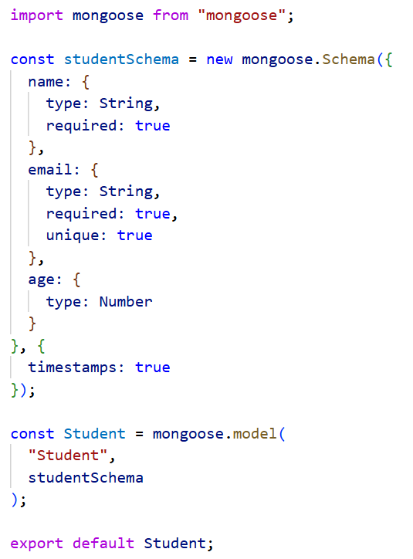

Slide 11
8. CRUD Operations
CRUD represents the four fundamental database operations.
Used to manage application resources.
Express routes receive client requests and execute corresponding Mongoose operations.
API responses communicate the result to the client.
Operation | Description | Mongoose Method
Create | Insert a new document | Model.create()
Read | Retrieve documents | Model.find()
Read One | Retrieve a single document | Model.findById()
Update | Modify a document | Model.findByIdAndUpdate()
Delete | Remove a document | Model.findByIdAndDelete()

Slide 12
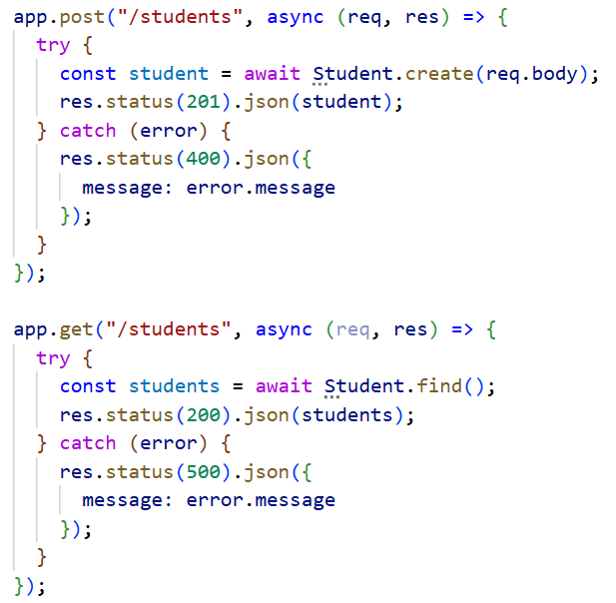

Slide 13
9. Database Error Handling
Error handling manages database failures and invalid operations.
Prevents unhandled errors from disrupting server execution.
Provides meaningful error responses to clients.
Helps identify and debug database-related issues.
Uses try...catch blocks and centralized error-handling middleware.

